Slide 1

Essentials of Economics
Seventh Edition
Chapter 8
Technology, Production, and Costs
Copyright © 2021, 2019, 2017 Pearson Education, Inc. All Rights Reserved.
Notes:
If this PowerPoint presentation contains mathematical equations, you may need to check that your computer has the following installed:
1) MathType Plugin
2) Math Player (free versions available)
3) NVDA Reader (free versions available)

Slide 2
Chapter Outline
8.1 Technology: An Economic Definition
8.2 The Short Run and the Long Run in Economics
8.3 The Marginal Product of Labor and the Average Product of Labor
8.4 The Relationship between Short-Run Production and Short-Run Cost
8.5 Graphing Cost Curves
8.6 Costs in the Long Run

Slide 3
8.1 Technology: An Economic Definition
What is technology and technological change?
The basic activity of a firm is to use inputs, for example
Workers,
Machines, and
Natural resources
to produce outputs of goods and services.
We call the process by which a firm does this a technology; if a firm improves its ability to turn inputs into outputs, we refer to this as a positive technological change.
Technology: The processes a firm uses to turn inputs into outputs of goods and services.
Technological change: A positive or negative change in the ability of a firm to produce a given level of output with a given quantity of inputs.

Slide 4
8.2 The Short Run and the Long Run in Economics
Distinguish between the economic short run and the economic long run.
Economists refer to the short run as the period of time during which at least one of a firm’s inputs is fixed.
Example: A firm might have a long-term lease on a factory that is too costly to get out of.
In the long run, the firm can vary all of its inputs, adopt new technology, and increase or decrease the size of its physical plant.
How long is the long run? It varies from firm to firm.
Think of it as “a long enough period of time that anything can be changed.”

Slide 5

Fixed, Variable, and Total Costs
The division of time into the short and long run reveals two types of costs:
Variable costs are costs that change as output changes
Fixed costs are costs that remain constant as output changes
In the long run, all of a firm’s costs are variable, since the long run is a sufficiently long time to alter the level of any input.
Total cost is the cost of all the inputs a firm uses in production:

Slide 6
Implicit Costs versus Explicit Costs
Explicit cost: A cost that involves spending money
Implicit cost: A nonmonetary opportunity cost
The explicit costs of running a firm are relatively easy to identify - just look at what the firm spends money on.
The implicit costs are a little harder - finding them involves identifying the resources used in the firm that could have been used for another beneficial purpose.
Example: If you own a firm, you probably spend time working on the firm’s activities. Even if you don’t “pay yourself” explicitly for that time, it is still an opportunity cost.

Slide 7
Table 8.1 Jill Johnson’s Costs per Year (1 of 2)
Jill’s Costs | Amount
Pizza dough, tomato sauce, and other ingredients | $ 20,000
Wages | 48,000
Interest payments on loan to buy pizza ovens | 10,000
Electricity | 6,000
Lease payment for store | 24,000
Forgone salary | 30,000
Forgone interest | 3,000
Economic depreciation | 10,000
Total | $ 151,000
Suppose Jill Johnson quits her $ 30,000 per-year job to start a pizza store. She uses $50,000 of her savings to buy equipment—furniture, etc.—and takes out a loan.
The first five items are explicit costs.
The remaining items are implicit costs.

Slide 8
Table 8.2 Short-Run Production and Cost at Jill Johnson’s Restaurant (1 of 2)
Quantity of Workers | Quantity of Pizza Ovens | Quantity of Pizzas per Week | Cost of Pizza Ovens (Fixed Cost) | Cost of Workers (Variable Cost) | Total Cost of Pizzas per Week | Cost per Pizza (Average Total Cost)
0 | 2 | 0 | $ 800 | $ 0 | $ 800 | —
1 | 2 | 200 | 800 | 650 | 1,450 | $ 7.25
2 | 2 | 450 | 800 | 1,300 | 2,100 | 4.67
3 | 2 | 550 | 800 | 1,950 | 2,750 | 5.00
4 | 2 | 600 | 800 | 2,600 | 3,400 | 5.67
5 | 2 | 625 | 800 | 3,250 | 4,050 | 6.48
6 | 2 | 640 | 800 | 3,900 | 4,700 | 7.34
Jill Johnson’s restaurant has a particular technology that transforms workers and pizza ovens into pizzas. With more workers, Jill can produce more pizzas.
This is the firm’s production function: the relationship between the inputs employed by a firm and the maximum output it can produce with those inputs.

Slide 9
Table 8.2 Short-Run Production and Cost at Jill Johnson’s Restaurant (2 of 2))
Quantity of Workers | Quantity of Pizza Ovens | Quantity of Pizzas per Week | Cost of Pizza Ovens (Fixed Cost) | Cost of Workers (Variable Cost) | Total Cost of Pizzas per Week | Cost per Pizza (Average Total Cost)
0 | 2 | 0 | $ 800 | $ 0 | $ 800 | —
1 | 2 | 200 | 800 | 650 | 1,450 | $ 7.25
2 | 2 | 450 | 800 | 1,300 | 2,100 | 4.67
3 | 2 | 550 | 800 | 1,950 | 2,750 | 5.00
4 | 2 | 600 | 800 | 2,600 | 3,400 | 5.67
5 | 2 | 625 | 800 | 3,250 | 4,050 | 6.48
6 | 2 | 640 | 800 | 3,900 | 4,700 | 7.34
If we divide the total cost of the pizzas by the number of pizzas, we get the average total cost of pizzas.
For low levels of production, the average cost falls as the number of pizzas rises; at higher levels, the average cost rises as the number of pizzas rises.

Slide 10
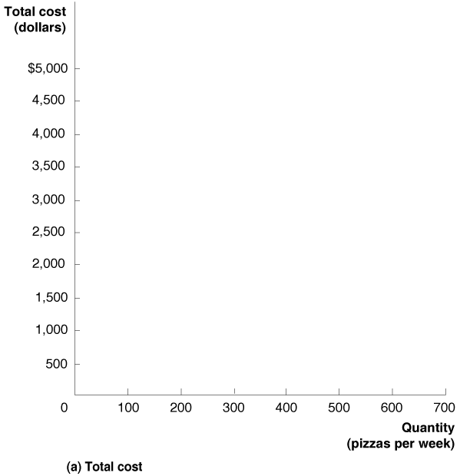
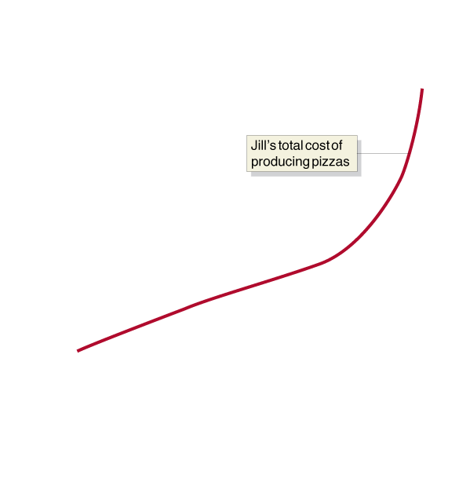
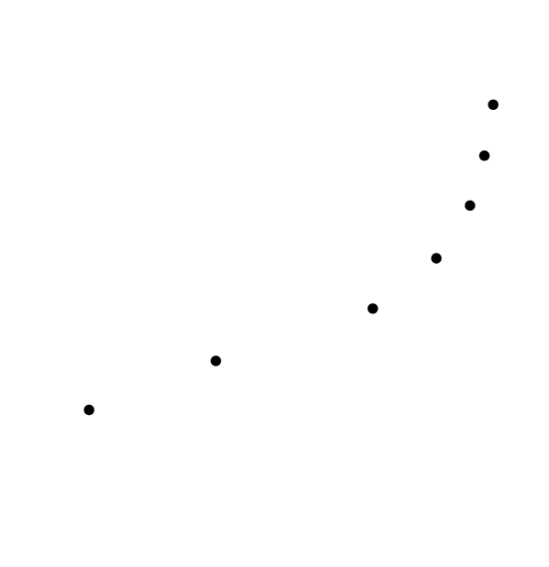
Figure 8.1 Graphing Total Cost and Average Total Cost at Jill Johnson’s Restaurant (1 of 2)
Using the information from the table, we can graph the costs for Jill Johnson’s restaurant.
Notice that cost is not zero when quantity is zero, because of the fixed cost of the pizza ovens.
Naturally, costs increase as Jill wants to make more pizzas.

Slide 11


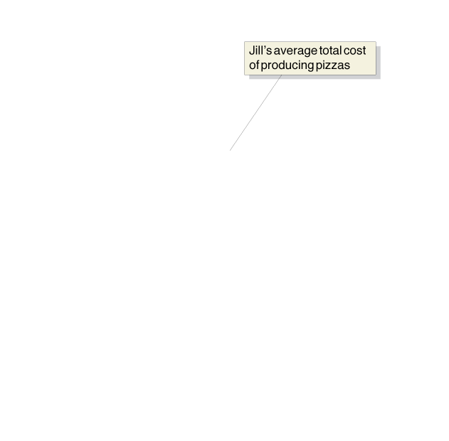
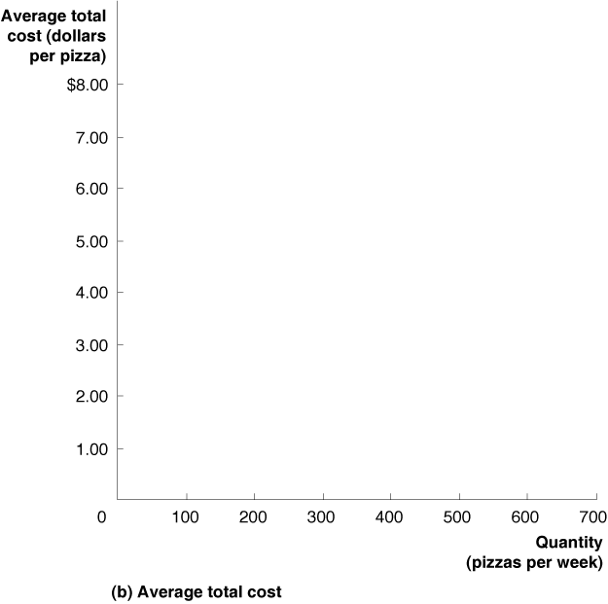
Figure 8.1 Graphing Total Cost and Average Total Cost at Jill Johnson’s Restaurant (2 of 2)
The “falling-then-rising” nature of average total costs results in a U-shaped average total cost curve.
Our next task is to examine why we get this shape for average total costs.

Slide 12
Table 8.3 The Marginal Product of Labor at Jill Johnson’s Restaurant (1 of 2)
Quantity of Workers | Quantity of Pizza Ovens | Quantity of Pizzas | Marginal Product of Labor
0 | 2 | 0 | —
1 | 2 | 200 | 200
2 | 2 | 450 | 250
3 | 2 | 550 | 100
4 | 2 | 600 | 50
5 | 2 | 625 | 25
6 | 2 | 640 | 15
Let’s examine what happens as Jill Johnson hires more workers.
To think about this, consider the marginal product of labor: the additional output a firm produces as a result of hiring one more worker.
The first worker increases output by 200 pizzas; the second increases output by 250.

Slide 13
Table 8.3 The Marginal Product of Labor at Jill Johnson’s Restaurant (2 of 2)
Quantity of Workers | Quantity of Pizza Ovens | Quantity of Pizzas | Marginal Product of Labor
0 | 2 | 0 | —
1 | 2 | 200 | 200
2 | 2 | 450 | 250
3 | 2 | 550 | 100
4 | 2 | 600 | 50
5 | 2 | 625 | 25
6 | 2 | 640 | 15
Additional workers add to the potential output but not by as much. Eventually they start getting in each other’s way, etc., because there is only a fixed number of pizza ovens, cash registers, etc.
Law of diminishing returns: The principle that, at some point, adding more of a variable input, such as labor, to the same amount of a fixed input, such as capital, will cause the marginal product of the variable input to decline.

Slide 14
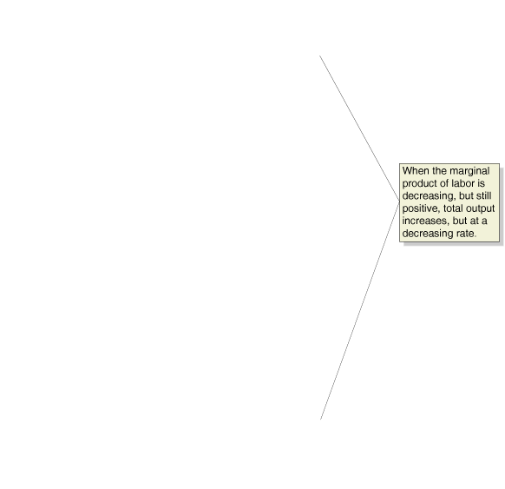
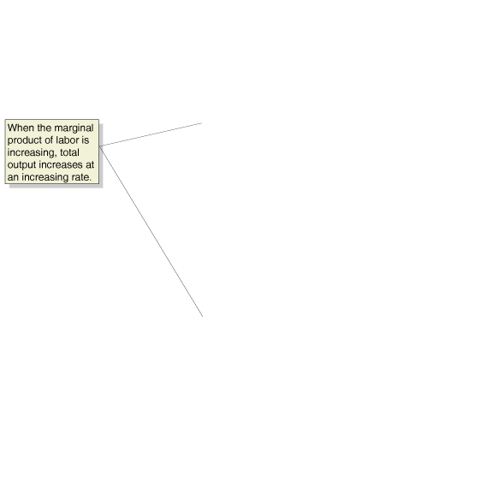





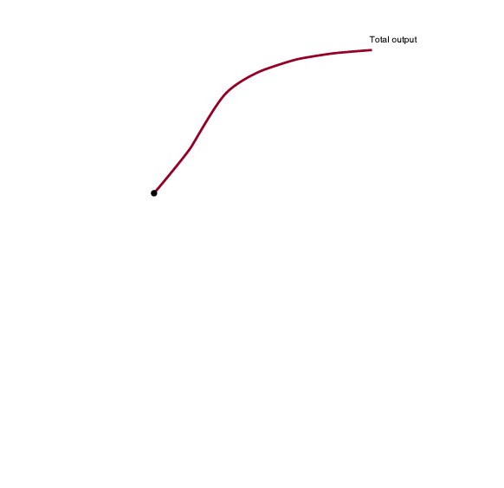
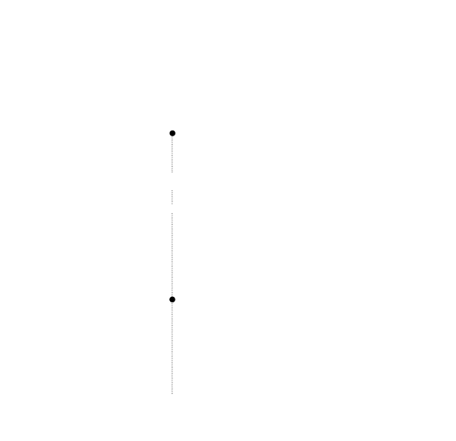
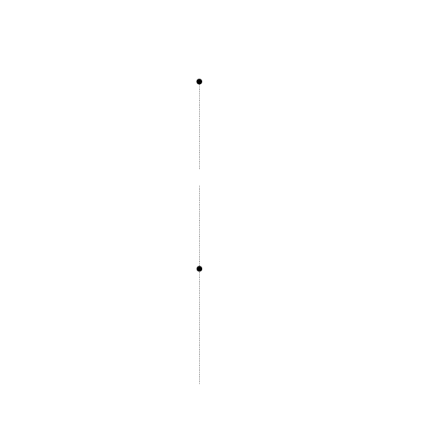
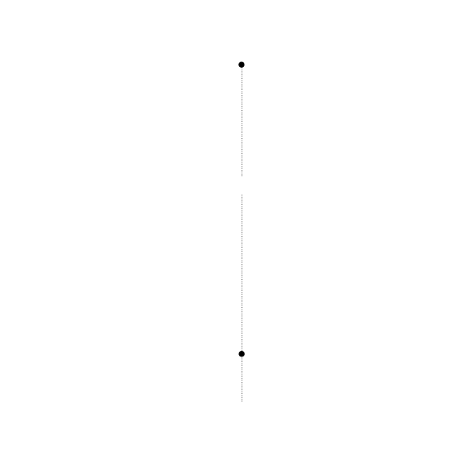
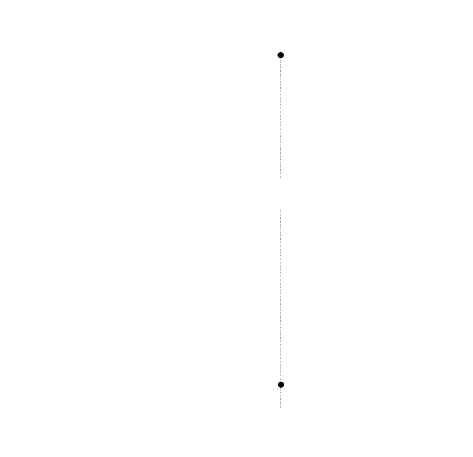
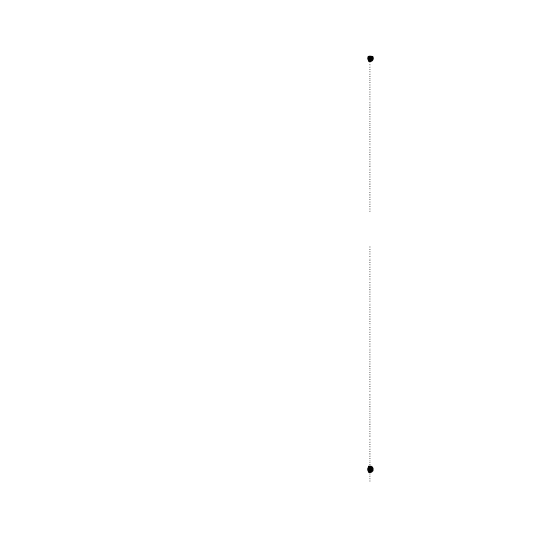
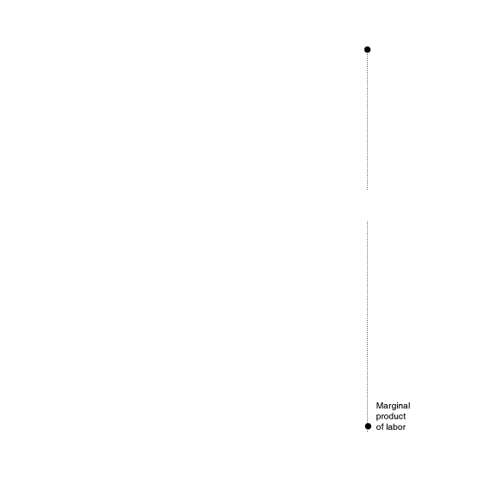
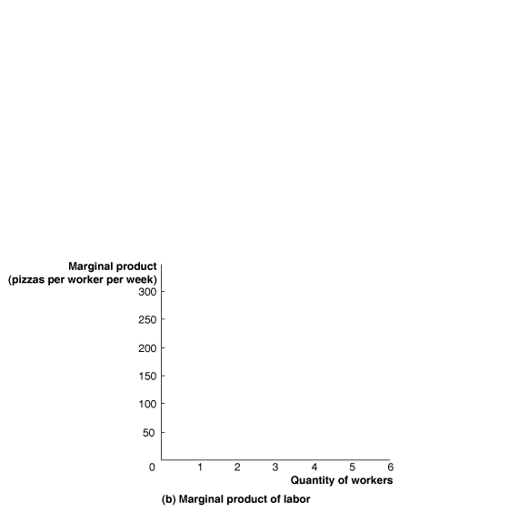
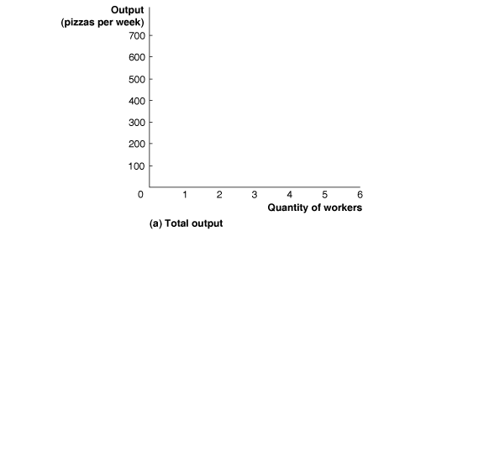
Figure 8.2 Total Output and the Marginal Product of Labor
Graphing the output and marginal product against the number of workers allows us to see the law of diminishing returns more clearly.
The output curve flattening out, and the decreasing marginal product curve, both illustrate the law of diminishing returns.

Slide 15
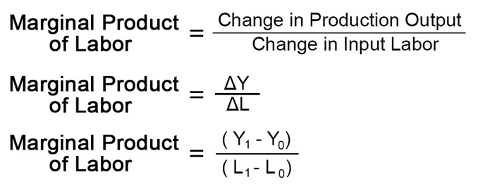
Calculating Marginal Product of Labor

Slide 16
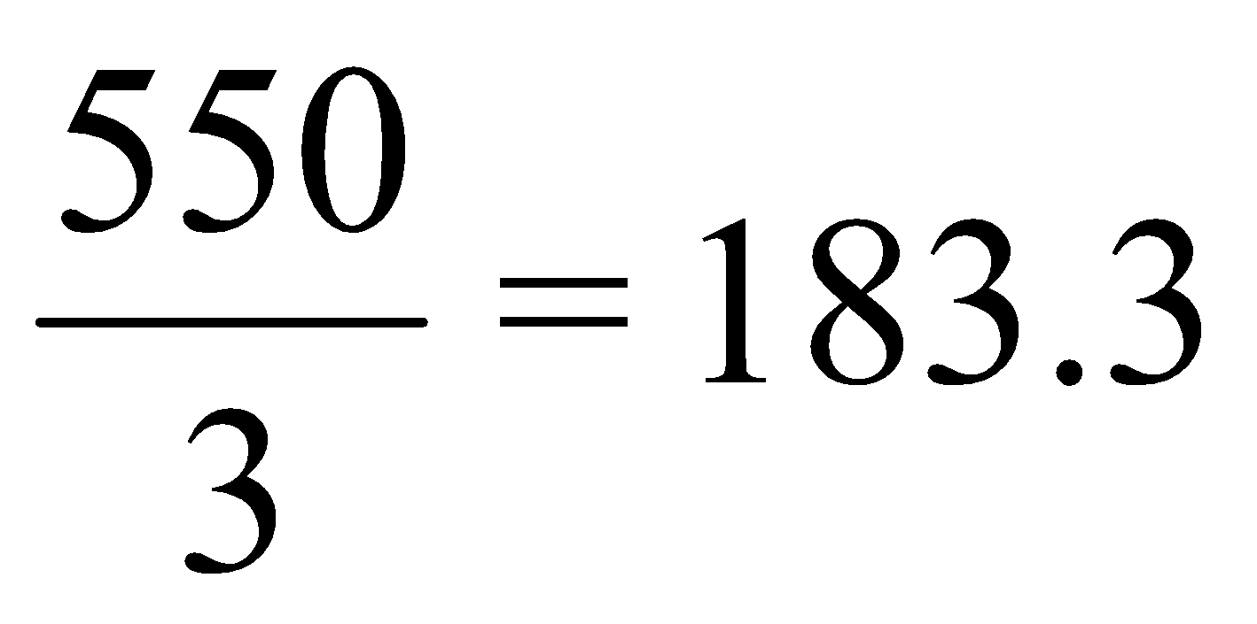
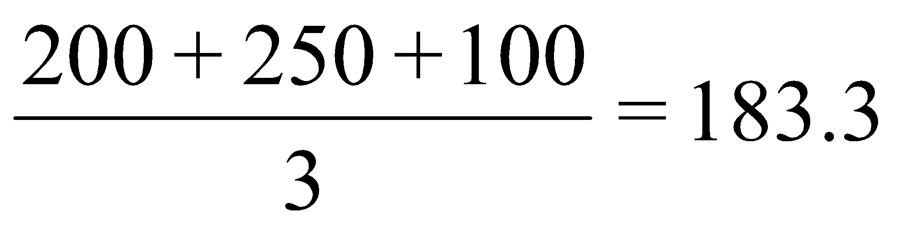
Average Product of Labor
Another useful indication of output is the average product of labor, the total output produced by a firm divided by the quantity of workers.
With 3 workers, the restaurant can produce 550 pizzas, giving an average product of labor of:
A useful way to think about this is that the average product of labor is the average of the marginal products of labor.
The first three workers give 200, 250, and 100 additional pizzas respectively:

Slide 17
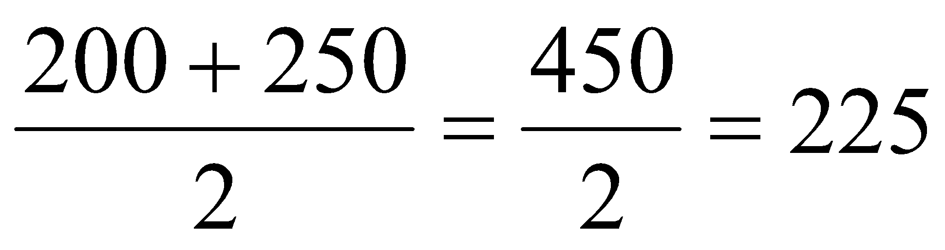
Average and Marginal Product of Labor
With only two workers, the average product of labor was:
So the third worker made the average product of labor go down.
This happened because the third worker produced less (marginal) output than the average of the previous workers

Slide 18
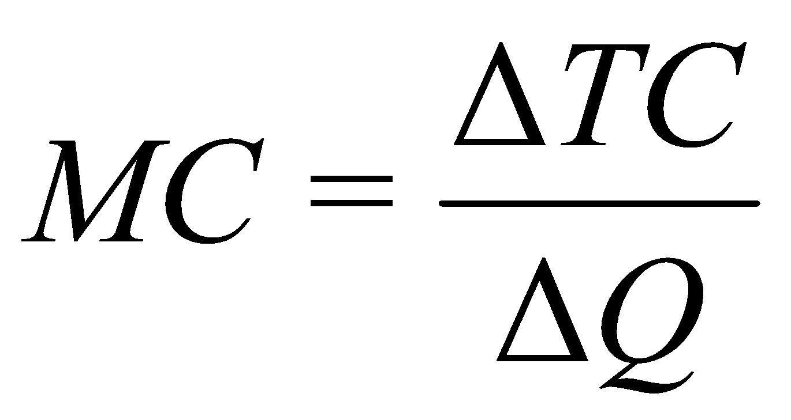
8.4 The Relationship between Short-Run Production and Short-Run Cost
Explain and illustrate the relationship between marginal cost and average total cost.
We have already seen the average total cost: total cost divided by output.
We can also define the marginal cost as the change in a firm’s total cost from producing one more unit of a good or service:
Sometimes ΔQ = 1, so we can ignore the bottom line, but don’t get in the habit of doing that, or you’ll make mistakes when quantity changes by more than 1 unit.

Slide 19
8.5 Graphing Cost Curves
Graph average total cost, average variable cost, average fixed cost, and marginal cost.
We know that total costs can be divided into fixed and variable costs:
TC = FC + VC
Dividing both sides by output (Q) gives a useful relationship:
TC / Q = FC / Q + VC / Q
The first quantity is average total cost.
The second is average fixed cost: fixed cost divided by the quantity of output produced.
The third is average variable cost: variable cost divided by the quantity of output produced.
So, ATC = AFC + AVC

Slide 20
8.6 Costs in the Long Run
Explain how firms use the long-run average cost curve in their planning.
Recall that the long run is a sufficiently long period of time that all costs are variable.
So In the long run, there is no distinction between fixed and variable costs.
A long-run average cost curve shows the lowest cost at which a firm is able to produce a given quantity of output in the long run, when no inputs are fixed.

Slide 21
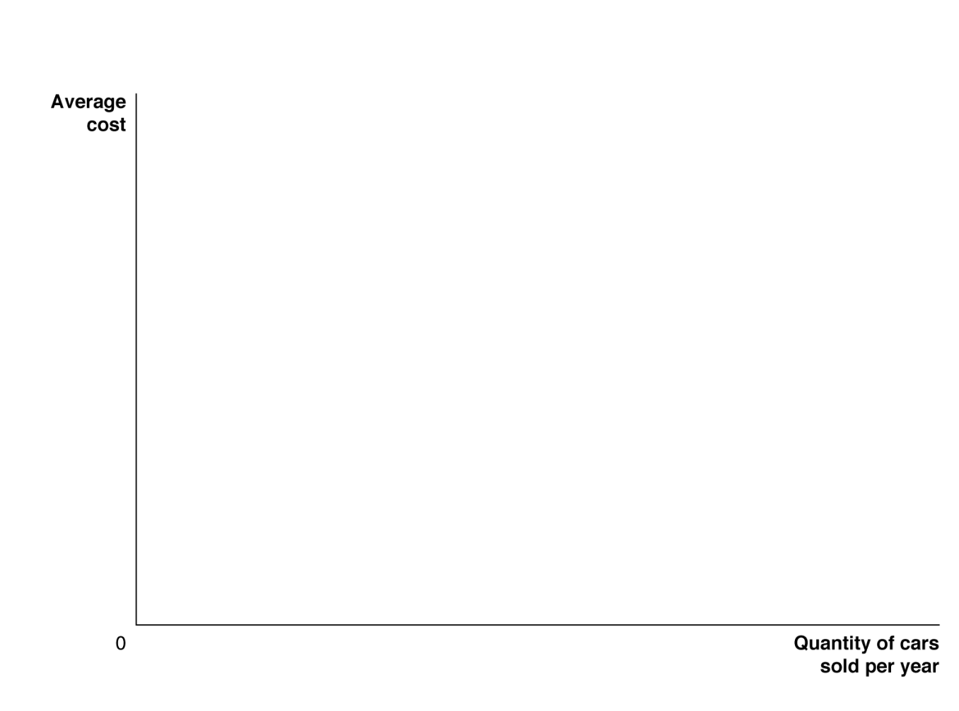
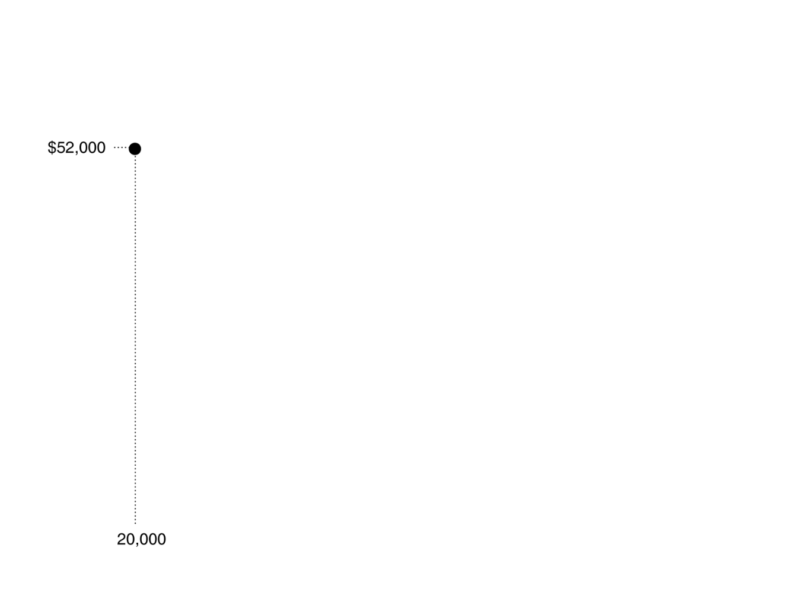

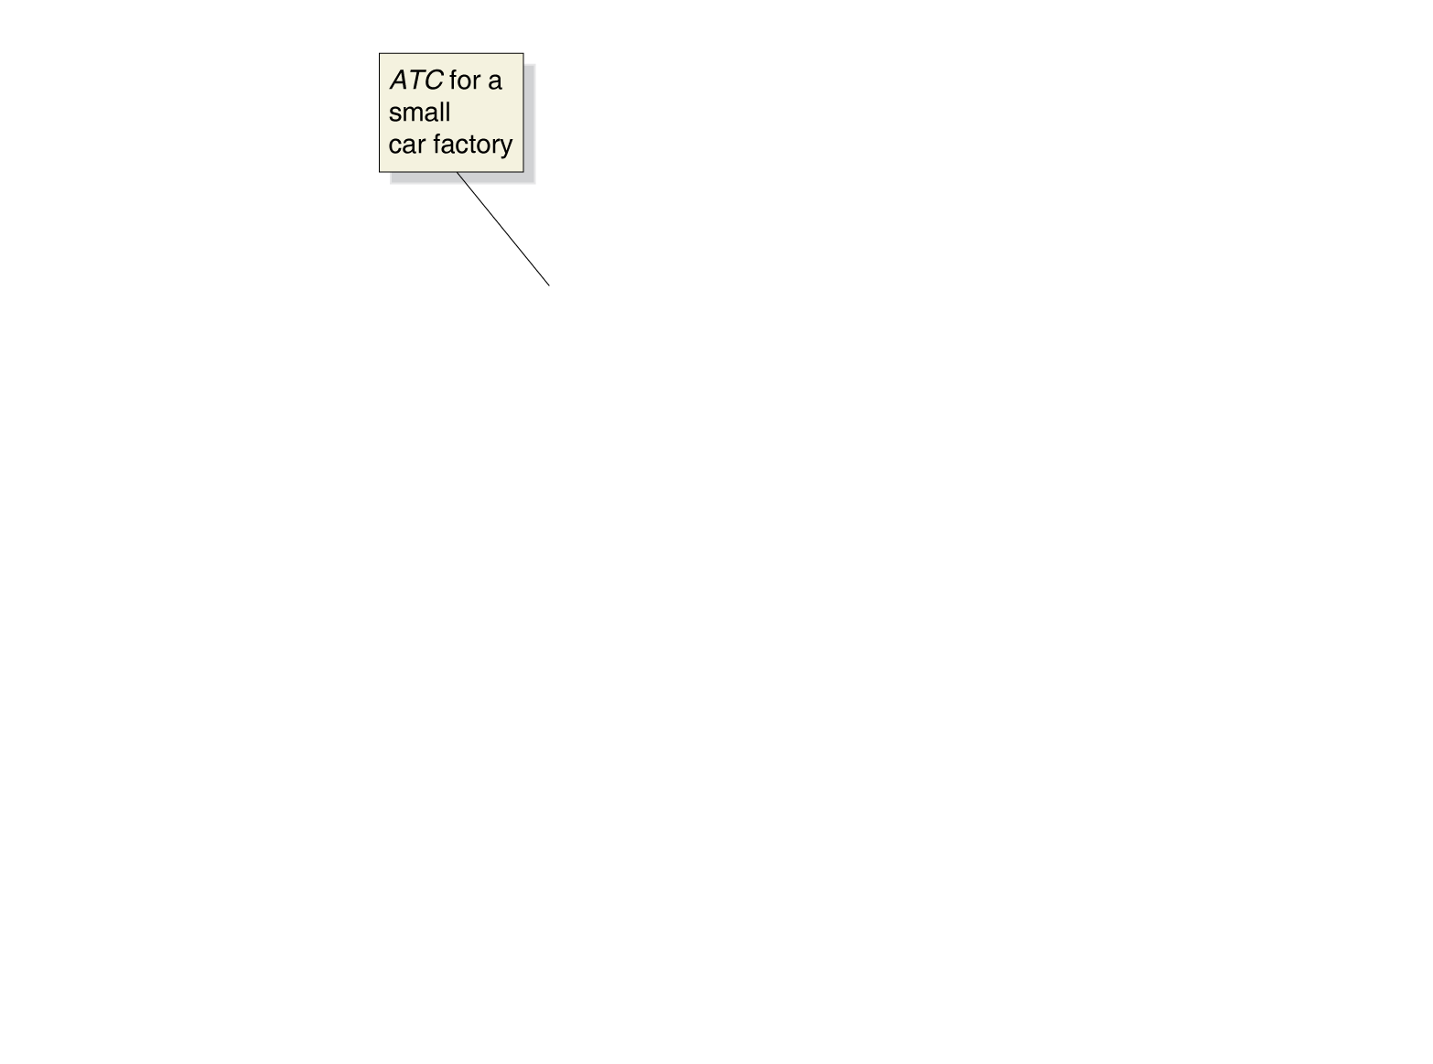
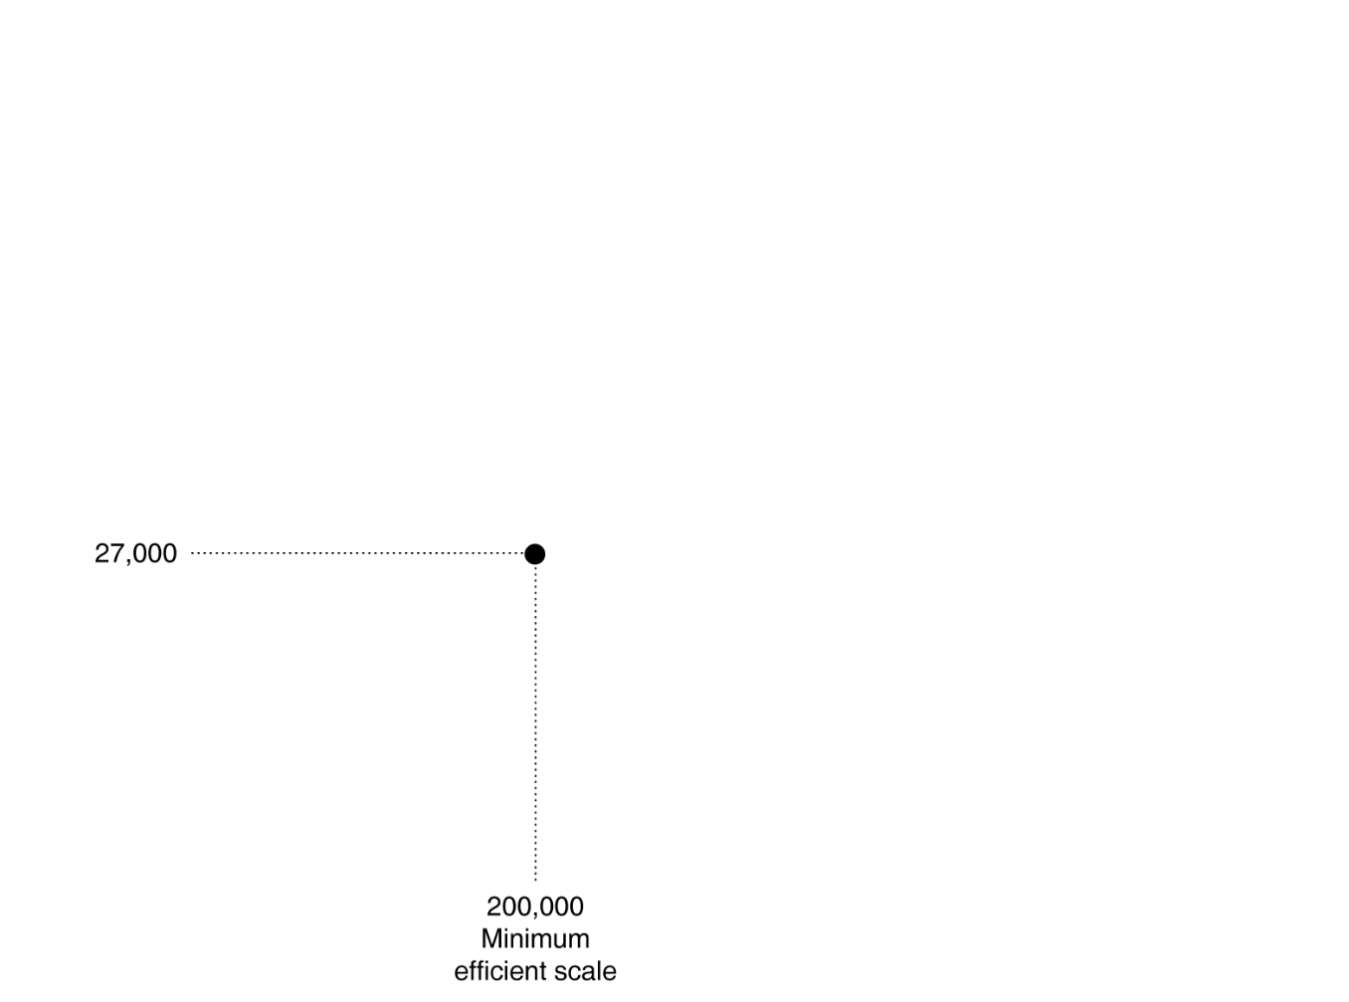

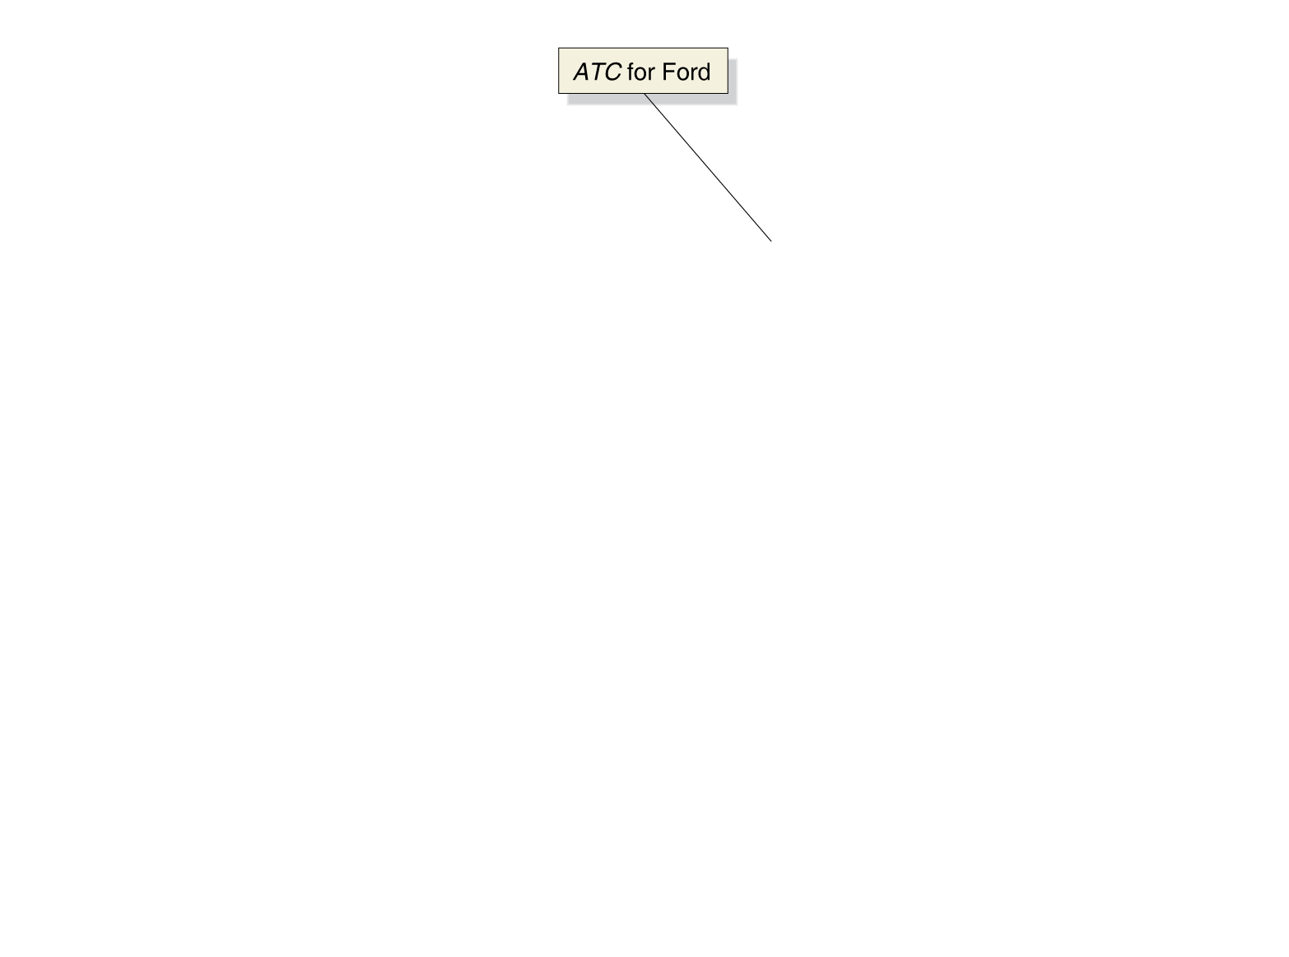
Figure 8.6 The Relationship between Short-Run Average Cost and Long-Run Average Cost (1 of 3)
At low quantities, a firm might experience economies of scale: the firm’s long-run average costs falling as it increases the quantity of output it produces.
Here, a small car factory can produce at a lower average cost than a large one, for small quantities. For more output, a larger factory is more efficient.

Slide 22
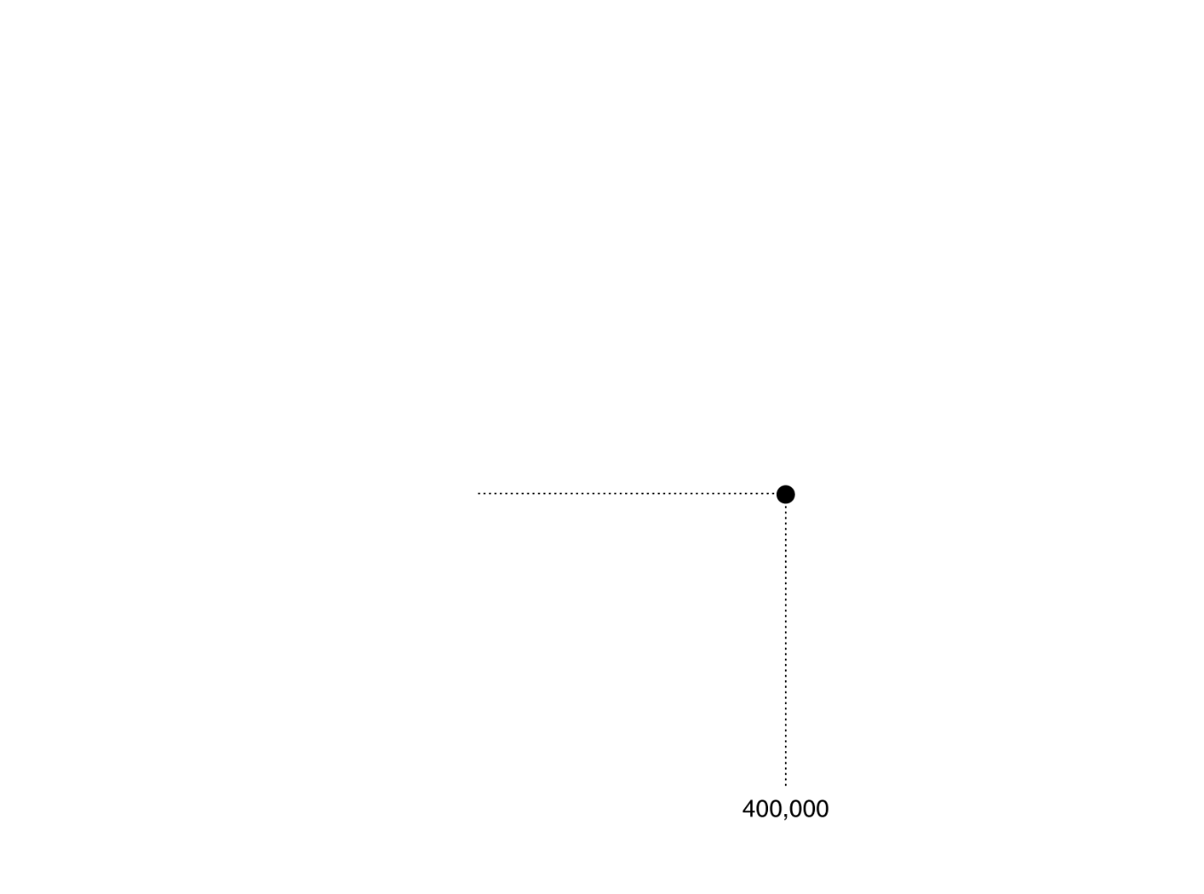

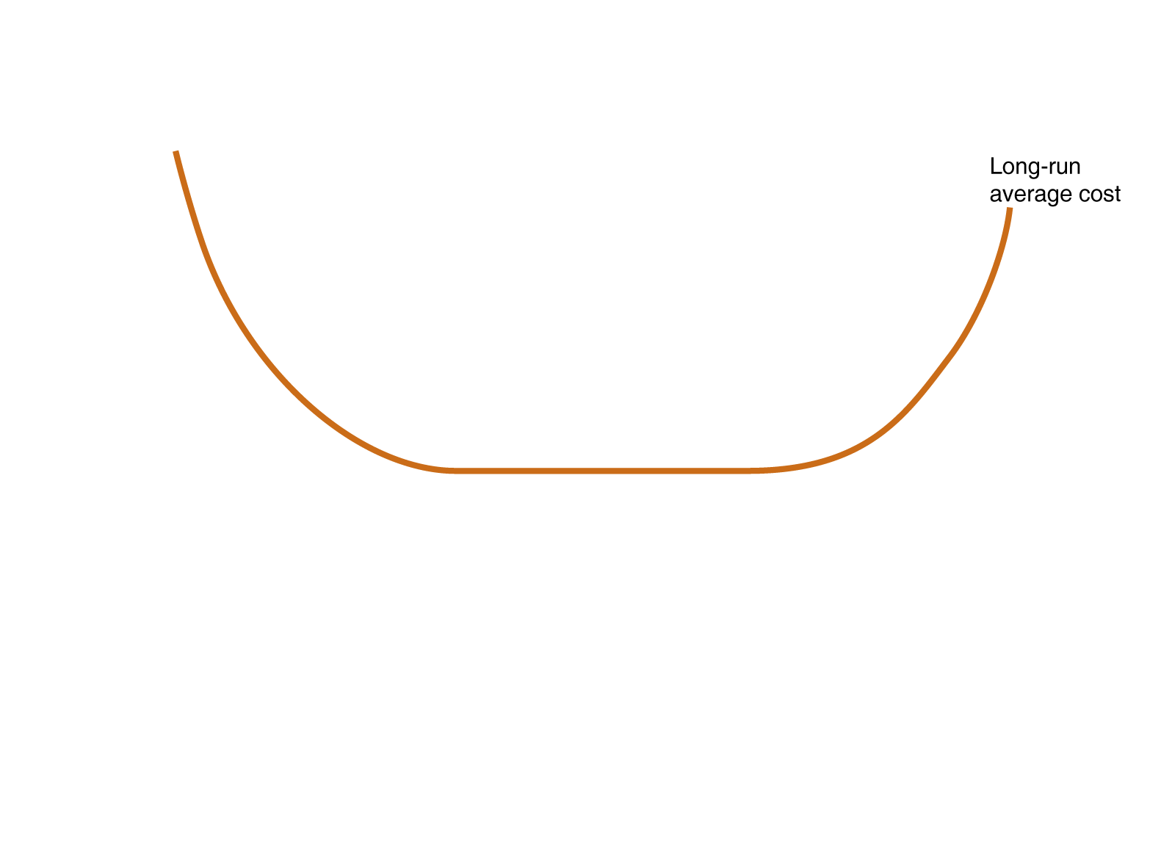
Figure 8.6 The Relationship between Short-Run Average Cost and Long-Run Average Cost (2 of 3)
The lowest level of output at which all economies of scale are exhausted is known as the minimum efficient scale.
At some point, growing larger does not allow more economies of scale. The firm experiences constant returns to scale: its long-run average cost remains unchanged as it increases output.

Slide 23
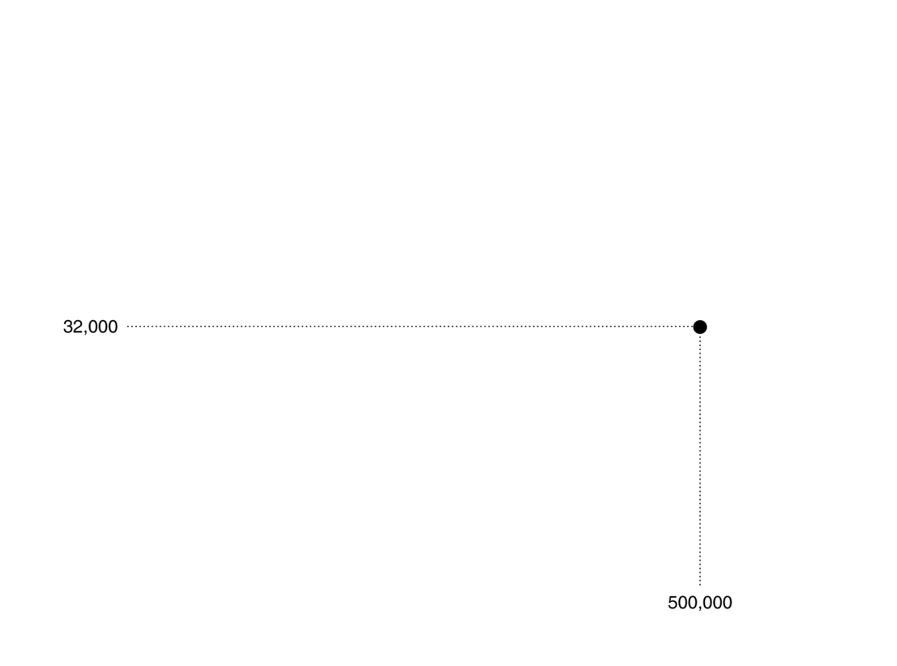

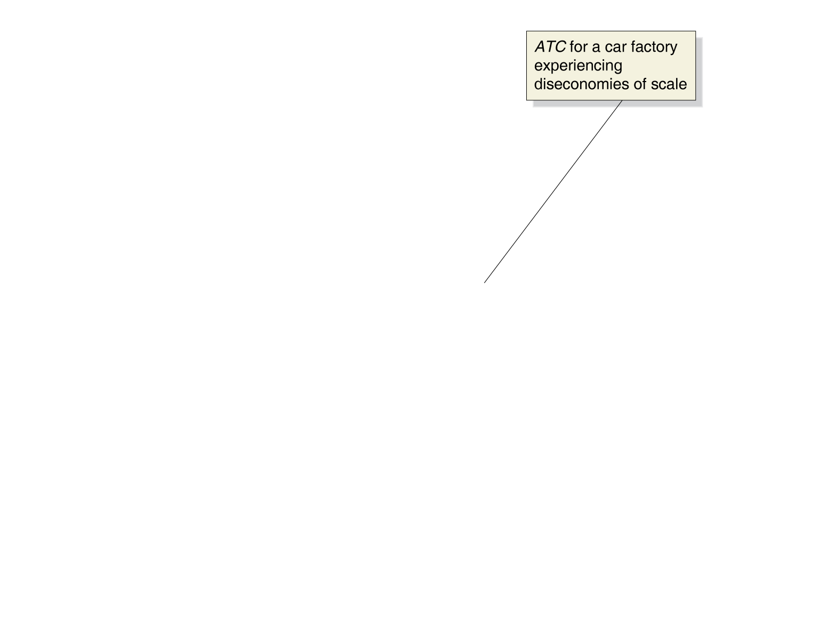
Figure 8.6 The Relationship between Short-Run Average Cost and Long-Run Average Cost (3 of 3)
Eventually, firms might get so large that they experience diseconomies of scale: a situation in which a firm’s long-run average costs rise as the firm increases output.
This might happen because the firm gets too large to manage effectively, or because the firm has to employ workers or other factors of production that are less well suited to production.

Slide 24
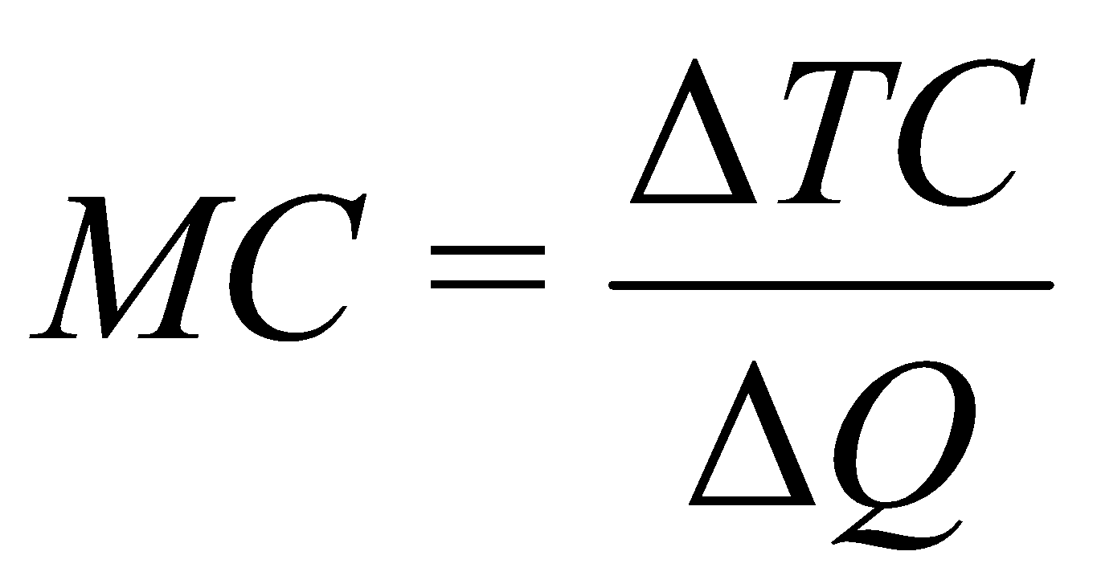
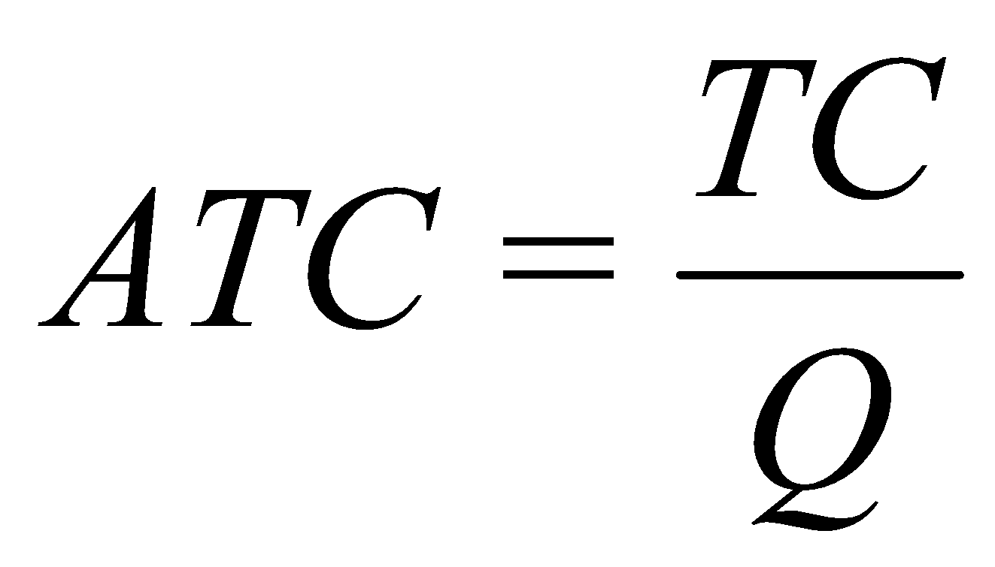
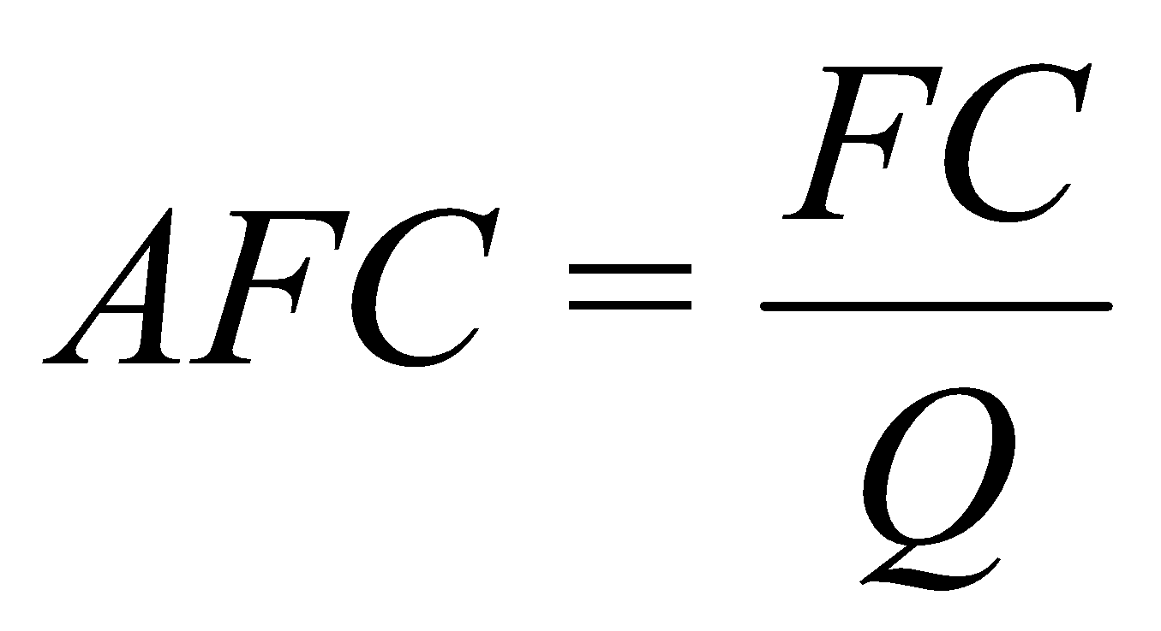
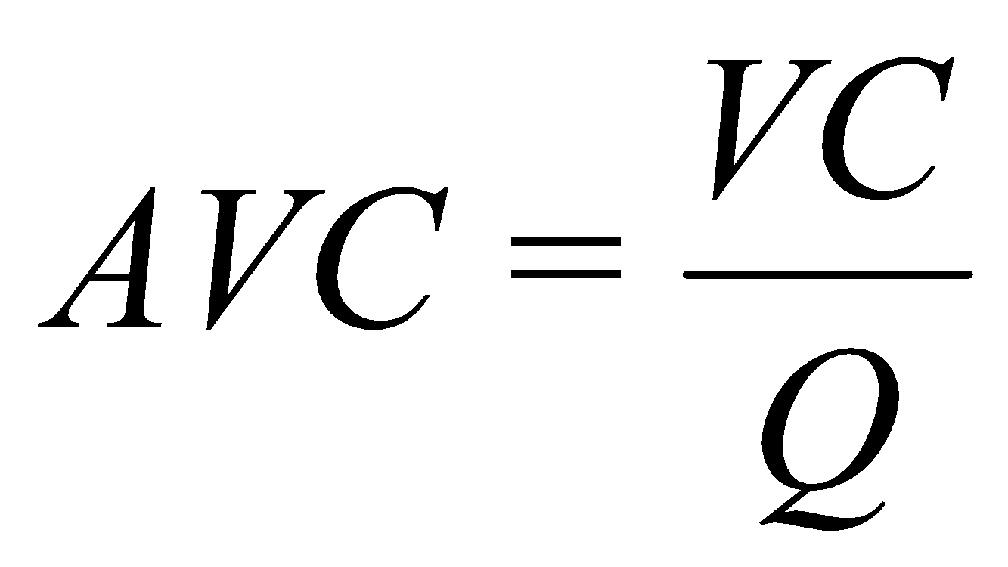
Table 8.4 A Summary of Definitions of Cost
Term | Definition | Symbols and Equations
Total cost | The cost of all the inputs used by a firm, or fixed costs plus variable costs | TC
Fixed costs | Costs that remain constant as a firm’s level of output changes | FC
Variable costs | Costs that change as a firm’s level of output changes | VC
Marginal cost | An increase in total cost resulting from producing another unit of output
Average total cost | Total cost divided by the quantity of output produced
Average fixed cost | Fixed cost divided by the quantity of output produced
Average variable cost | Variable cost divided by the quantity of output produced
Implicit cost | A nonmonetary opportunity cost | —
Explicit cost | A cost that involves spending money | —

Slide 25

Copyright

